Slide 1
NAST/NAUPA
Presented by: Marisa Horsley and Sam Tongue
CONFIDENTIAL DISCLAIMER

Slide 2
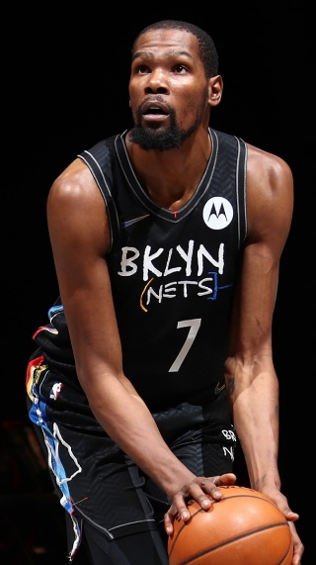
The Most Influential Voices In Audio
WE ARE AUDACY.
An audio universe of discovery and connection. Fueled by dynamic innovation. With advertising solutions that drive exceptional results.
INNOVATIONS IN CONTENT
FIRST PARTY DATA + PREMIERE DATA PARTNERS
Audience Solutions
Attribution
Data Services
SUCCESSFUL PARTNERSHIPS
Immersive Engagement
We provide the news our fans need. The sports they love. The podcasts they crave. The music they can’t live without. Live and on-demand.
Original, premium content, made by humans, available everywhere, on every device. Meet our audiences on their time and when they’re most engaged to hear and respond to your message.
Trusted Influence
Our listeners, our communities, connect deeply with talent they trust and know. Coming from voices our communities rely upon, your messages have real impact, and spark real action.
Exceptional Results for Brands
Innovation secures our leadership position in the audio universe.
First party data fuels our deep understanding of our listeners and drives effective advertising campaigns for our partners.
Dynamic innovation and powerful analytics fuel creative and smart solutions that drive measurable results for brands.
2
CONFIDENTIAL DISCLAIMER

Slide 3
Audacy Audio
Audacy Digital Streaming + Podcasts
3
CONFIDENTIAL DISCLAIMER

Slide 4
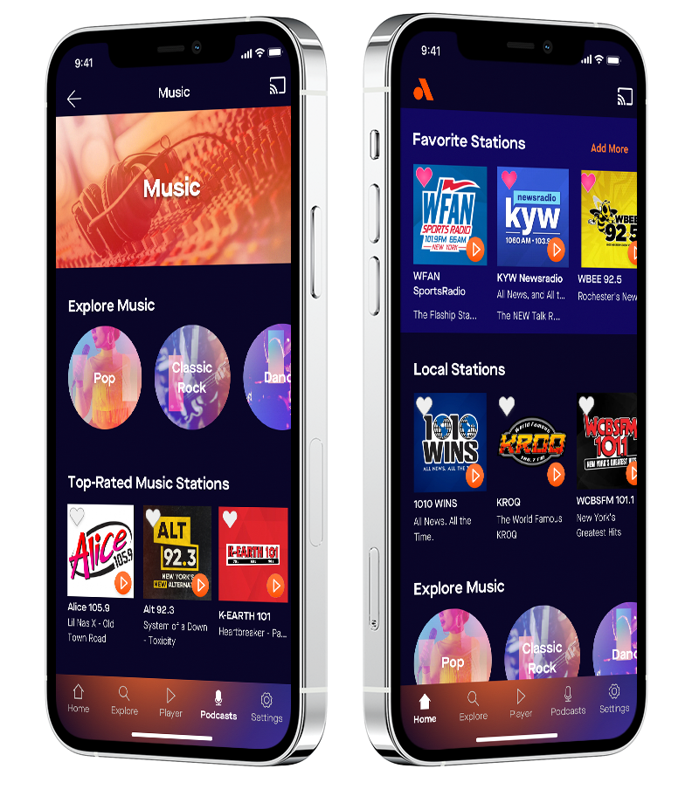
Digital Audio: Sparking Connection and Discovery
The #1 fastest-growing digital audio platform in the U.S.
The best collection of original, live, and on-demand content across Music, News, Sports, Entertainment and more
68M
1,200+
2M+
Monthly Digital Listeners
Streaming Stations
Podcasts
SMART SPEAKERS | AUDACY APP
OTT | AUDACY.COM | STATION WEBSITES
1ST & 3RD PARTY TARGETING
Distributed by all major platforms
Apple, Google Home, Waze, Sonos, Alexa, Apple TV, Logotech, Google Play, Apple HomePod, and more

Slide 5
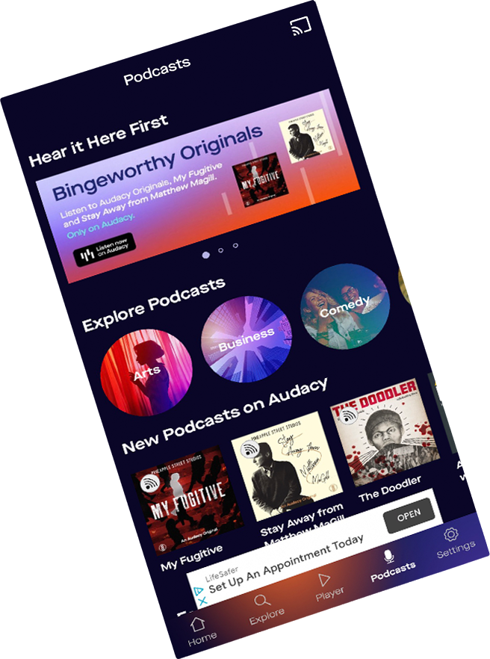
Streaming & Podcasts
ADOBE + AUDACY | DIGITAL CAPABILITIES
A complete digital audio platform with the best collection of original, live and on-demand content across entertainment, music, news, sports and podcasts
Fastest growing digital audio app in the U.S. with 1,100+ streaming stations, 40,500+ podcasts and 68 million monthly unique listeners
Delivers to an exclusive audience not delivered by Pandora, Spotify or iHeartRadio
Audacy is more upscale and affluent, and more likely to be music trend-setters than our competitors
Audiences can be targeted based on device location, demographics, and advanced behavioral targets
We can offer custom radio stations, podcasting opportunities, sponsorship opportunities and MORE
5
CONFIDENTIAL DISCLAIMER

Slide 6
SLIDES 5,6,7 BUILD OFF EACH OTHER. DO NO EDIT / ALTER. ANIMATION WILL BE LOST.
68M+
U.S. DIGITAL AUDIENCE
41.5M
47.7M
36.9M
200M+ U.S. TOTAL

Slide 7
Audio Samples
Holiday Dedicated to Unclaimed Property
Get Back What’s Yours

Slide 8
Pricing
NAST | AUDACY PORTLAND
Asset | CPM
Digital Audio :30 ad + companion banner | $10-$13 | Custom media plan available upon request
Digital Audio ADAN plan :30 ad + companion banner (includes podcasts) | $16.50 | Custom media plan available upon request

Slide 9
Thank You,
Marisa Horsley
Marisa.Horsley@audacy.com
503-409-4889
Sam Tongue
Sam.Tongue@audacy.com
503-998-3043

Slide 10
Appendix
CONFIDENTIAL DISCLAIMER
10

Slide 11
INTEGRATED PLATFORM
STREAMING, SITES & SOCIAL
Social Media Marketing
Display Ads
Video
Email
E-Commerce
BROADCAST
Personality Endorsements
Branded Content
In-show Integrations
Contests and Promotions
Reaching our total audience wherever they are, however they choose to connect.
PODCASTS
Host Endorsements
Organic Integrations
Branded Podcasts
National and Local
EVENTS & EXPERIENCES
Concerts & Events
Live Podcast Events
Sampling
Retail Activation
CSR
11
CONFIDENTIAL DISCLAIMER

Slide 12
Digital Dashboard
CONFIDENTIAL DISCLAIMER
12

Slide 13
Dashboard
AUDACY DIGITAL CAPABILITIES
Transparent Reporting for Exemplary Results
We set high standards for integrity and performance; that’s why we’ve built a fully integrated dashboard with our full Audacy Digital suite. We always follow through on our commitments and offer a transparent dashboard with key business metrics to hold us accountable for delivering exemplary results.
Reporting Metrics That Matter
Impressions
Clicks & Click Through Rate
Video Completion Rate
Reach and Frequency
Device Types
Geography
And Many More
Available 24/7
Fully integrated into the Reporting Dashboard
CONFIDENTIAL DISCLAIMER
13

